Slide 1
Data Structures
Jesse Kaminsky 8/5/2025
Modified from slides made by Dexter Tsin

Slide 2
Table of contents
General definition of data structures
Linear: queue/ stack/ linked list
Non-linear: tree/ graph
Python data structures
List, Dictionaries, Tuple, Set
Applications and functions of python data structures
References

Slide 3
Definition of data structures (in Computer Science)
From Wikipedia …
“Data structure is a data organization, management, and storage format that is usually chosen for efficient access to data”
Collection of values
Relationship between values
Functions and operations to apply on the data

Slide 4
Categories of data structures
Abstract data types:
Linear data structure
Data elements are arranged sequentially, where each element is attached to previous and adjacent element
Only one level
Examples: Stack, Queue, Linked list
Non-linear data structure
Data elements are not arranged in particular order, where each element is connected to one or more elements
Example types: Graph, Trees

Slide 5

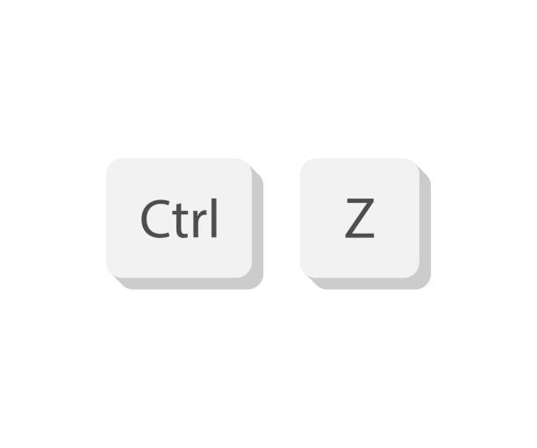
Linear data structures Stack, Queue, Linked list
Stack (Last in, First out):
Objects are inserted into the data structure, but only the most recent object can be accessed/ removed
Examples: Tennis cans, undo/ redo traces in type systems

Slide 6
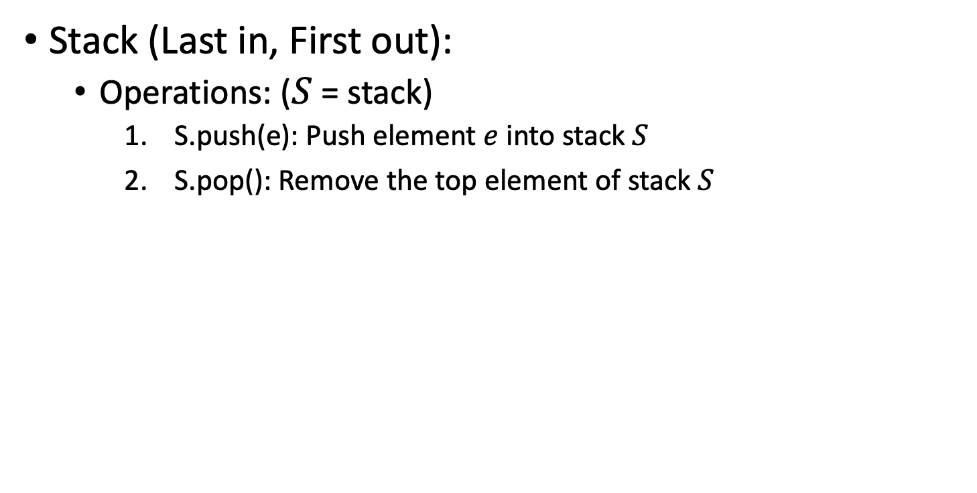
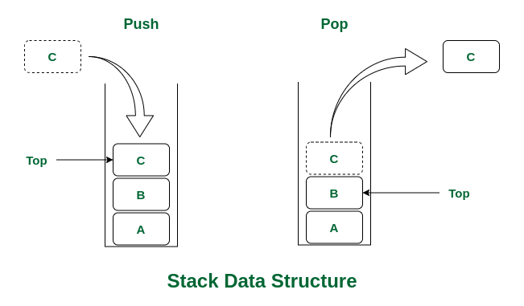
Linear data structures Stack, Queue, Linked list

Slide 7
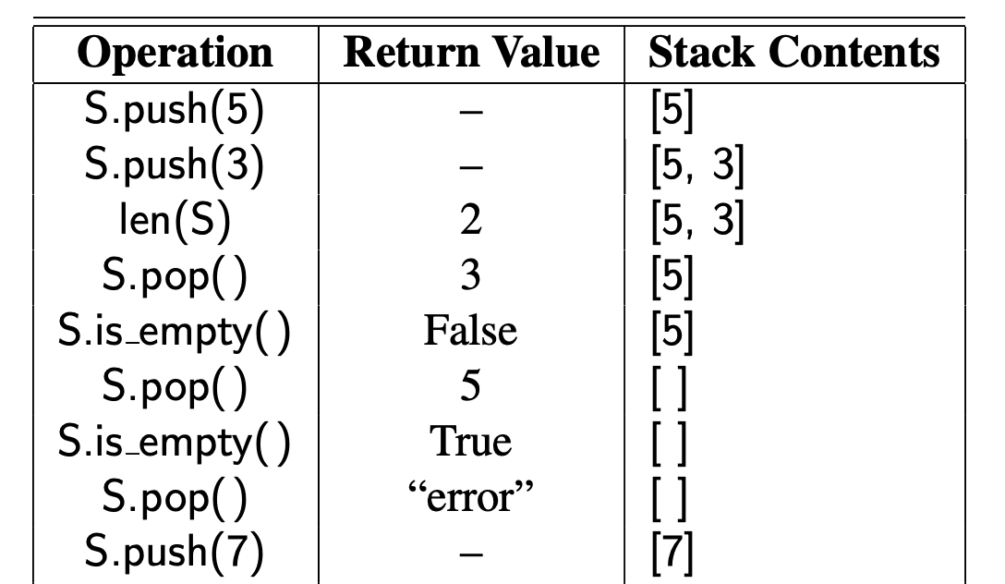
Linear data structures Stack, Queue, Linked list
Stack (Last in, First out):

Slide 8
Linear data structures Stack, Queue, Linked list
Stack (Last in, First out):

Slide 9
Linear data structures Stack, Queue, Linked list
Stack (Last in, First out):

Slide 10
Linear data structures Stack, Queue, Linked list
Stack (Last in, First out):

Slide 11
Linear data structures Stack, Queue, Linked list
Stack (Last in, First out):

Slide 12
Linear data structures Stack, Queue, Linked list
Stack (Last in, First out):

Slide 13
Linear data structures Stack, Queue, Linked list
Stack (Last in, First out):

Slide 14
Linear data structures Stack, Queue, Linked list
Stack (Last in, First out):

Slide 15
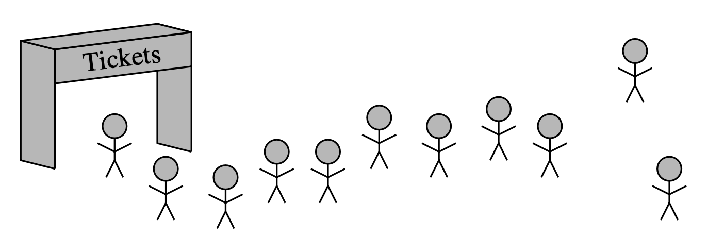
Linear data structures Stack, Queue, Linked list
Queue (First in, First out):
Objects are inserted into the end of the queue, but only the first object in the queue is removed
Examples: queues for the best pastries in town

Slide 16
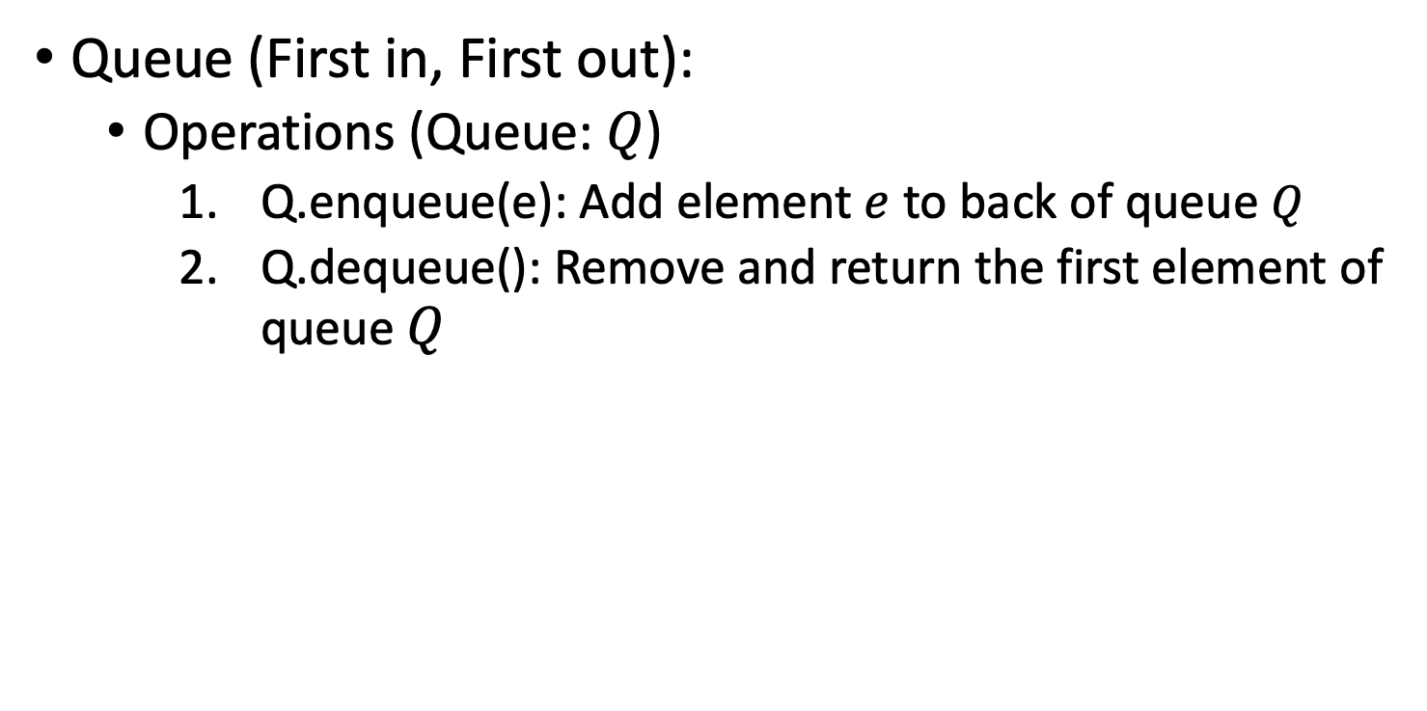
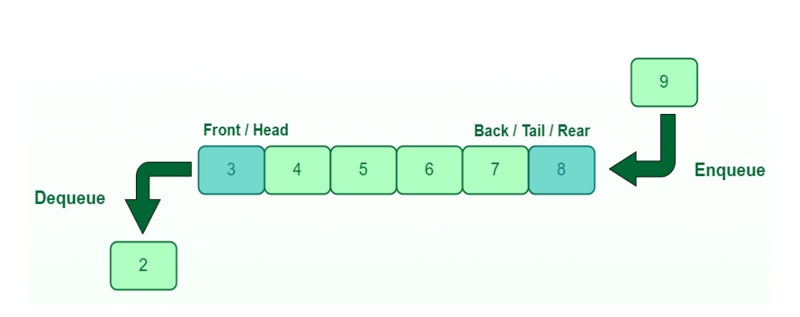
Linear data structures Stack, Queue, Linked list

Slide 17
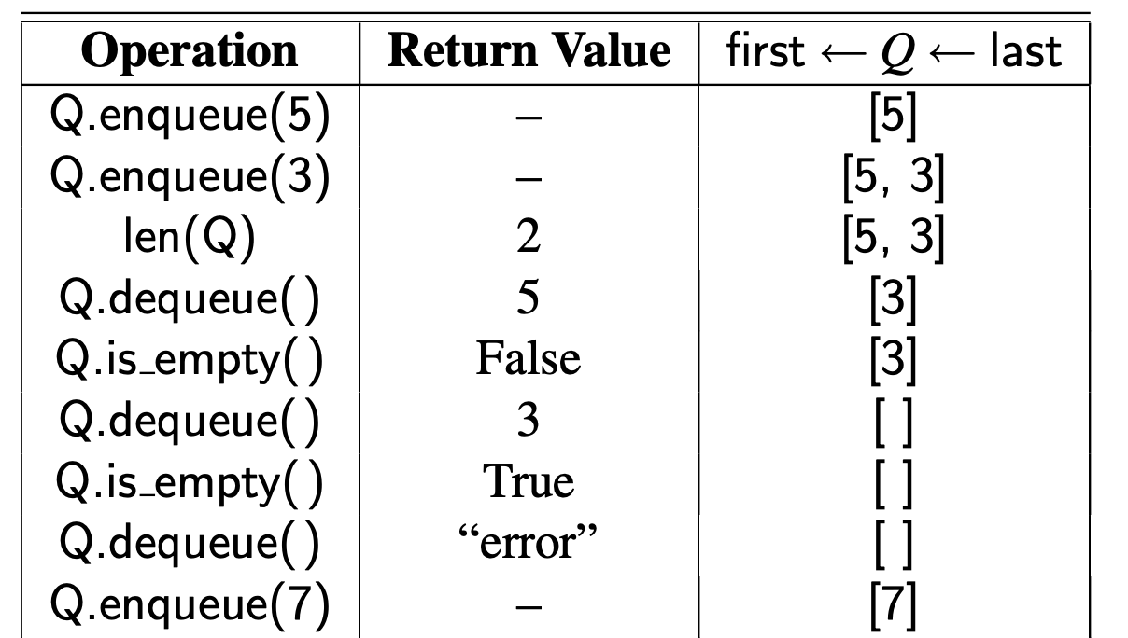
Linear data structures Stack, Queue, Linked list
Queue (First in, First out):

Slide 18
Linear data structures Stack, Queue, Linked list
Queue (First in, First out):

Slide 19
Linear data structures Stack, Queue, Linked list
Queue (First in, First out):

Slide 20
Linear data structures Stack, Queue, Linked list
Queue (First in, First out):

Slide 21
Linear data structures Stack, Queue, Linked list
Queue (First in, First out):

Slide 22
Linear data structures Stack, Queue, Linked list
Queue (First in, First out):

Slide 23
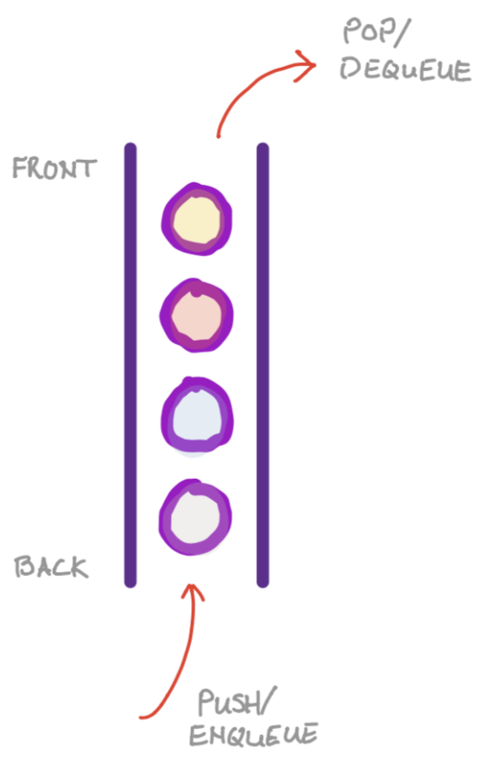
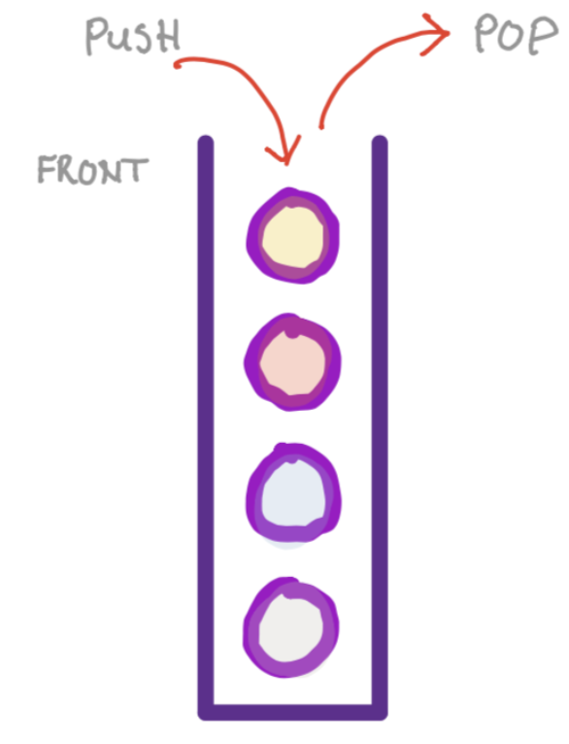
Linear data structures Stack, Queue, Linked list
_____:
(Last in, First out)
_____:
(First in, First out)

Slide 24
Linear data structures Stack, Queue, Linked list
Stack :
(Last in, First out)
Queue:
(First in, First out)

Slide 25
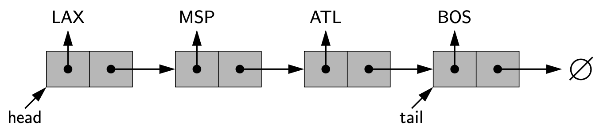
Linear data structures Stack, Queue, Linked list
(Single) Linked list
A collection of nodes that form a linear sequence
Node: object + reference to the next node
Object | Reference
Object | Reference

Slide 26
Linear data structures Stack, Queue, Linked list
(Single) Linked list
A collection of nodes that form a linear sequence
Node: object + reference to the next node
Object | Reference
Object | Reference
Object | Reference
Object | Reference

Slide 27
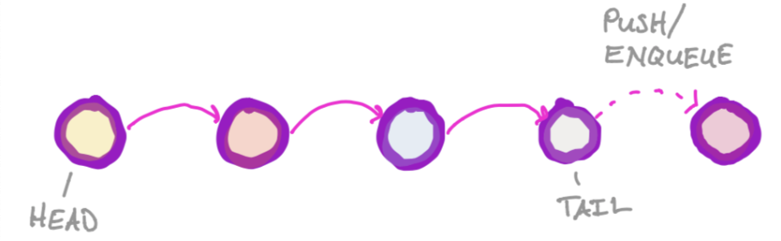
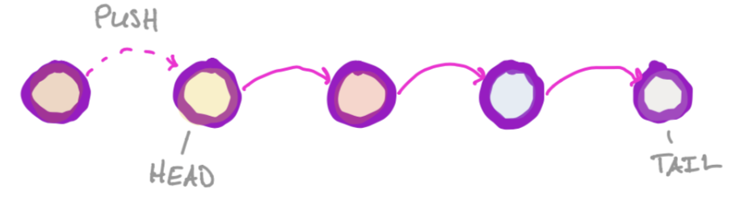
Linear data structures Stack, Queue, Linked list
(Single) Linked list
More abstract data type that can construct stack and queue
Queue adaptation:
Stack adaptation:

Slide 28
Python native data structures
List: [1, 2, 3, 3]
Tuple: (‘a’, ‘b’, ‘c’)
Dictionary: {‘a’:1, ‘b’:2}
Set: {‘a’, ‘b’, ‘c’, ‘d’, ‘1’}

Slide 29
Lists: introduction
Python lists are used to store multiple items in a single variable
Syntax: square brackets []
e.g.: list1 = [‘a’, ‘b’, ‘c’, ‘d’, ‘e’, ‘f’]
Properties
Lists can contain duplicate items
Lists can contain items with distinct types
e.g.: list_mixed = [1, “a”, True, 4]

Slide 30
Lists: Indexing (positive/ negative), slicing
list1 = [‘a’,‘b’,‘c’,‘d’,‘e’,‘f’]
IMPORTANT: Python is 0 indexed (as all things should ☺ )
So the first item is the 0th item instead of the 1st item
Indexing:
List is accessed as, syntax: list_variable[index]
list1[0] = ‘a’
However index can also be negative (counting from backward)
list1[-1] = ‘f’

Slide 31
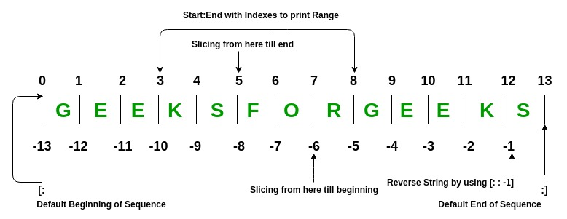
Lists: Indexing (positive/ negative), slicing
List1[3:8]
List1[5:]
List1[:-6]

Slide 32
Lists: Indexing (positive/ negative), slicing
list1 = [‘a’,‘b’,‘c’,‘d’,‘e’,‘f’]
IMPORTANT: Python is 0 indexed (as all things should ☺ )
So the first item is the 0th item instead of the 1st item
Slicing
Accessing a range of values, syntax: list_variable[Initial: end, interval]
End positive index is exclusive
e.g. list1[1:4] = [‘b’,‘c’,‘d’] (from index 1 to index (4 -1) = 3)
e.g. list1[::2] = [‘a’,‘c’,‘e’] (Jump every 1 item)
e.g. list1[1:4:2] = [‘b’,’d’] (from index 1 to 3, jump every 1 item)

Slide 33
Lists: Indexing (positive/ negative), slicing
list1 = [‘a’,‘b’,‘c’,‘d’,‘e’,‘f’]
IMPORTANT: Python is 0 indexed (as all things should ☺ )
So the first item is the 0th item instead of the 1st item
Slicing
Accessing a range of values, syntax: list_variable[Initial: end, interval]
End positive index is exclusive
e.g. list1[-4:-1] = [‘c’,‘d’,‘e’] (Starting the 4th item to the last item from the end)
e.g. list1[-4:-1:3] = ?

Slide 34
Lists: Indexing (positive/ negative), slicing
list1 = [‘a’,‘b’,‘c’,‘d’,‘e’,‘f’]
IMPORTANT: Python is 0 indexed (as all things should ☺ )
So the first item is the 0th item instead of the 1st item
Slicing
Accessing a range of values, syntax: list_variable[Initial: end, interval]
End positive index is exclusive
e.g. list1[-4:-1] = [‘c’, ‘d’, ‘e’] (Staring the 4th item to the last item from the end)
e.g. list1[-4:-1:3] = [‘c’]

Slide 35
Lists: Reversing a list
list1 = [‘a’,‘b’,‘c’,‘d’,‘e’,‘f’]
IMPORTANT: Python is 0 indexed (as all things should ☺ )
So the first item is the 0th item instead of the 1st item
Reversing
reverse() reverses a list
e.g. list1.reverse() = [’f’, ‘e’, ‘d’, ‘c’, ’b’, ‘a’]
[::-1] also reverses a list (indexing in reverse)
e.g. list1[::-1] = [’f’, ‘e’, ‘d’, ‘c’, ’b’, ‘a’]

Slide 36
Lists: adding and removing elements
list1 = [‘a’,‘b’,‘c’,‘d’,‘e’,‘f’]
Adding elements:
append(value): append adds elements to the end of a list
e.g. list1.append(‘g’) = [‘a’,‘b’,‘c’,‘d’,‘e’,‘f’,‘g’]
Insert(index, value): insert adds elements to particular position
e.g list1.insert(1, ‘g’) = [‘a’,‘g’,‘b’,‘c’,‘d’,‘e’,‘f’]
Removing elements:
remove(value): remove only value from the list (first value)
e.g. list1.remove(‘a’) -> list1 = [‘b’,‘c’,‘d’,‘e’,‘f’]
(Assume list1 = [’a’,‘a’,‘b’,‘c’]) list1.remove(‘a’) = [‘a’,’b’,’c’]
Pop(optional: index): remove value at index from the list (last value if not specified)
e.g. last = list1.pop() -> last = [‘f’], list1 = [‘a’,‘b’,‘c’,‘d’,‘e’]
e.g. list1.pop(2) -> list1 = [‘a’,‘b’,‘d’,‘e’,‘f’]

Slide 37
Lists: handy functions
list1 = [‘a’,‘b’,‘c’,‘d’,‘e’,‘f’]
index(value): Find index of the first value in a list
e.g. list1.index(’d’) = 3
len(): Return the length of the list
e.g. len(list1) = 6
Count(value): Return the number of occurrences in a list
e.g. list1.count(’a’) = 1
sort(reverse = False): Sort the lists in ascending order
e.g. list1.sort(reverse = True) = [‘f’, ’e’, ‘d’, ‘c’,’b’,’a’]
in: Return a Boolean indicating if item exists in a list
e.g. ‘a’ in list1 = True
Max()/ min(): return the max and min value of a list
e.g. max(list1) = ‘f’, min(list1) = ‘a’

Slide 38
Lists: list comprehension
List comprehension is a shorter(fancy) way to create new lists
Syntax: newlist = [expression for item in list if something]
Use case: Allows for conditional filtering/ manipulation for a new list
e.g. list_old = [3, 4, 5, 6, 7, 8, 9, 10]
Goal: make a new list that only has number larger than 5
new_list = [i for i in list_old if x > 5]

Slide 39
Tuple: Introduction
Tuple is very similar to lists, but the biggest difference is that tuple elements cannot be changed after assignment
Syntax: brackets ()
e.g. my_tuple = (‘a’,‘b’,‘c’,‘d’,‘e’)
Functions are similar to that of lists

Slide 40
Dictionary: Introduction
Dictionaries store elements in the format (key:value), where values are stored related to a unique key
Keys can be different data types as long as they are distinct
Syntax: {key:value}
e.g. my_dict = {‘a’: 1, ‘b’: 2, ‘c’: 3}

Slide 41
Dictionary: accessing, adding and removing elements
my_dict = {‘a’: 1,‘b’: 2,‘c’: 3}
Accessing value from key:
my_dict[‘b’] = 2
Adding new key-value pair:
my_dict[‘d’] = 4
Removing existing key-value pair
del my_dict[‘c’]

Slide 42
Dictionary: Useful functions
my_dict = {‘a’: 1,‘b’: 2,‘c’: 3}
Accessing all keys
my_dict.keys() = dict_keys([‘a’,‘b’,’c’])
Accessing all values
my_dict.values() = dict_values([1,2,3])
How to convert to lists?
list(my_dict.keys())
[i for i in my_dict.keys()]

Slide 43
Set: Introduction
Set is used to store multiple items also
Features: all items are not ordered, not indexed, and not changeable
No duplicates are allowed in the set
Syntax: Curly brackets{}
e.g. my_set = {‘a’, ‘b’, ‘c’}

Slide 44
References
Geeksforgeeks - Data Structures and Algorithms for beginners
Data Structures and Algorithms in Python – (Goodrich, Tamassia, Goldwasser)
CS 225 – Data Structures (UIUC)

